Slide 1
Cryptocurrency Volatility versus Media Influence
By: The CryptoKrakens
David Sharp, Milena Hablaszek, Nicklaus Ng, Kiran Bano

Slide 2
Presumption
Cryptocurrency has a reputation for being very volatile. It has recently seen explosive price growth, which has generated investment interest in this particular area. However, many people have refrained from investing in Cryptocurrencies, because of a reputation of high volatility, a lack of regulation, and Cryptocurrencies are generally not an acceptable method of payment for most products or services.
Furthermore, Cryptocurrency is a very new phenomenon, only having entered mainstream vernacular in the last few years.
Over time, and particular with the meteoric rise of Bitcoin, some Cryptocurrencies are now starting to be seen as a genuine investment option.
We sought to clarify these assertions, and see whether Cryptocurrencies are becoming more stable (or less volatile) as time has passed, and if the currencies are becoming more stable as they become more mainstream.
Furthermore, we sought to clarify if Social Media and Traditional Media sources were having an effect on cryptocurrency prices, trade volumes, and volatility.

Slide 3
Cryptocurrency Facts and Figures
Cryptocurrencies are fascinating for several reasons.
Cryptocurrencies are “mined” through a process of computers solving cryptographic equations, and adding transactions to Blockchain. This process uses a massive amount of energy.
If Bitcoin was a country, it would be in the top 30 energy users worldwide. (Source: University of Cambridge Bitcoin Electricity Consumption Index)
Cryptocurrency is driven by a relatively new technology called Blockchain. Blockchain is a distributed ledger, transaction data is stored in blocks that are chained together, and distributed. Therefore, no single group, individual or technology has control over the ledger. All data entered is irreversible and permanently recorded.
The current price of 1 bitcoin is an astonishing AUD$69,948 at time of writing (Friday night, 26/3/21)

Slide 4
Key Questions
We asked three key questions during our investigations.
Are cryptocurrencies more volatile than traditional currencies?
Are there any visible trends in volatility rates of cryptocurrencies over time, either positive or negative? Are Cryptocurrencies becoming less volatile (more stable investments) as they become more mainstream?
Is there a correlation between tweets / social media word mentions / trends / sentiment, versus cryptocurrency prices, trade volumes and volatility?

Slide 5
Data Sources
We anticipated gathering data for traditional and cryptocurrencies to be straightforward. However, in reality, it was a little more complex. Data needed to be cleaned and modified to suit our needs. Furthermore, we required up-to-date data, which was hard to find without resorting to paid APIs.
There were three key sources of data that were used:
Cryptocurrency Data – containing the prices of various coins over a period of several years. Cryptocurrency data is available but much of it was dated.
Traditional Currency Data – prices of various traditional currencies over a period of several years. This data was available from international government and state resources. We gathered our Traditional Currency data from the International Monetary Fund.
Social Media Data – searching for patterns, Social Media Mentions and Tags, and traditional media articles mentioning cryptocurrency, Bitcoin in particular. This data was quite constrained. Despite the overwhelming prevalence of social media in our lives, that data is proprietary and can be expensive to access. Free data on the subject is limited.

Slide 6
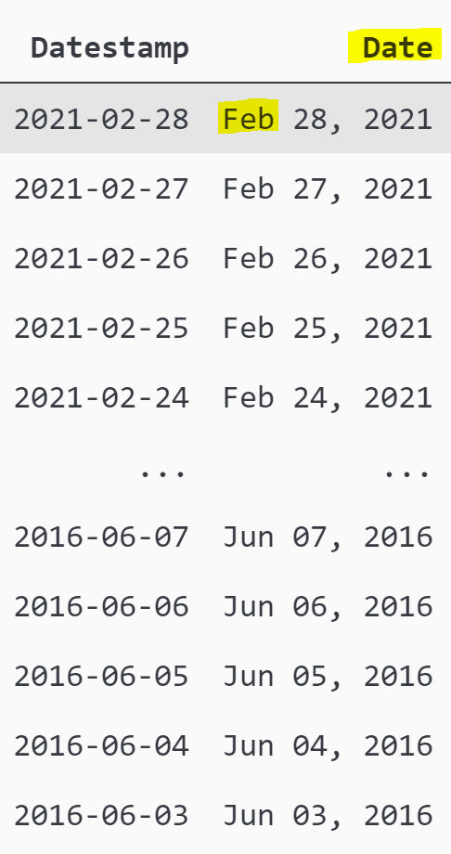
Data Cleanup
Each data source required it’s own cleanup, particularly the following areas:
Dates and Date formatting, reading dates in as string and converting to Datestamps using pd.to_datetime() and sorting chronologically
Dealing with junk data at the header and footer of the Traditional Currency dataset, and removing this before importing
Combining data from disparate sources into a single dataframe for comparison (e.g. Google Trends data + Bitcoin data)
Throughout the process, we encountered corrupt file problems, file format issue, problems with columns and headers, datestamp formatting inconsistency, and inconsistencies within the data itself. All of these had to be resolved through a variety of means.

Slide 7
What is Volatility?
Volatility could be defined as the amount and frequency of price movement of a particular asset class
Volatility could also be defined as prices being likely to change rapidly and unpredictably
This means there are several avenues to explore for volatility analysis:
Raw Price growth and Price falls
Standard Deviation of prices over the course of a time-period (i.e. how much does a month’s prices vary from the mean?)
Differentials of a time-period’s highest and lowest prices
Number of transactions and standard deviation of transaction volumes

Slide 8
Question 1:
Are Crypto Currencies More Volatile than Traditional Currencies?
Kraken: Nick

Slide 9
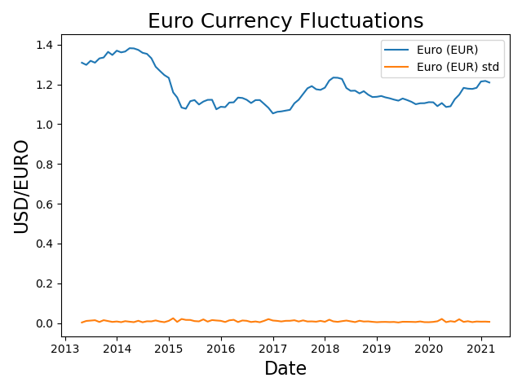
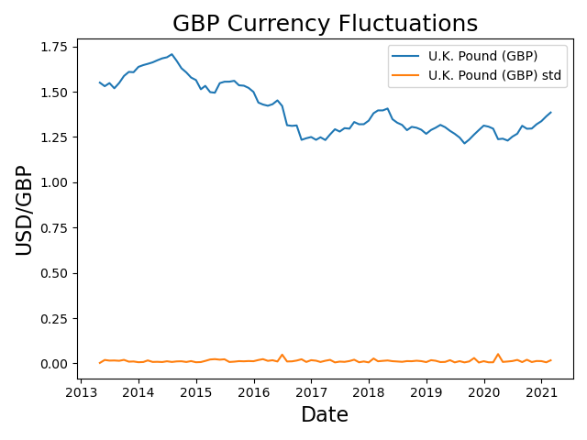
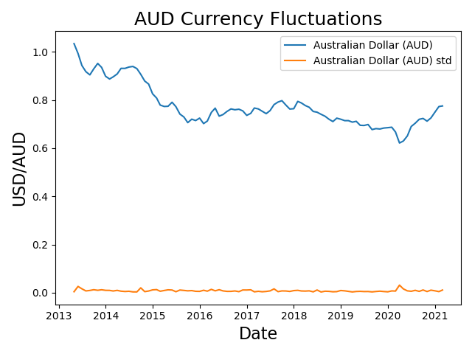
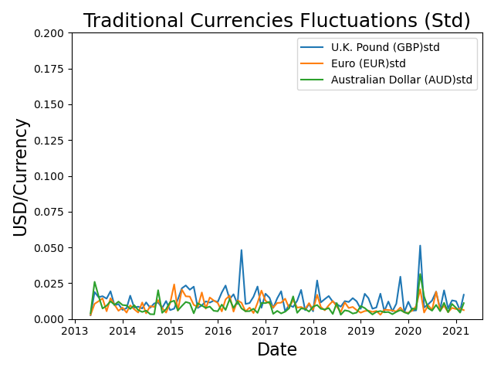
Traditional Currencies
Volatility in the Foreign Exchange market allows for opportunities to buy low and sell favourably (Lows and Highs).
Graphs show Euro, GBP and AUD against the USD over a period of 8 years.
In these graph, we are able to observe relative stability within traditional currencies, as highlighted by the Standard Deviation of the currencies.

Slide 10
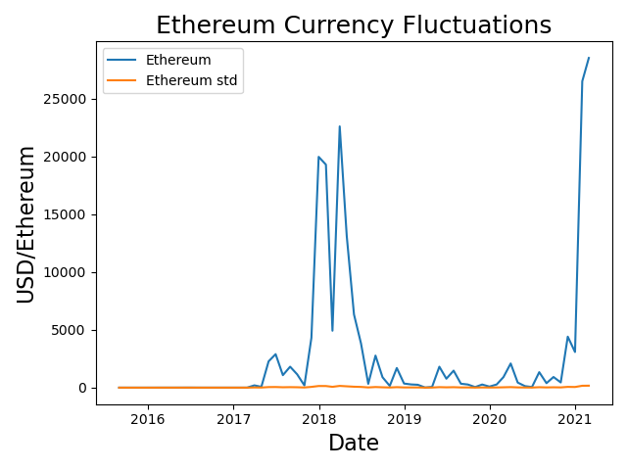
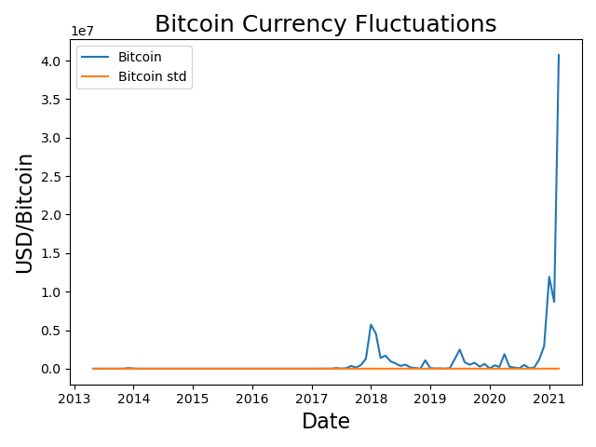
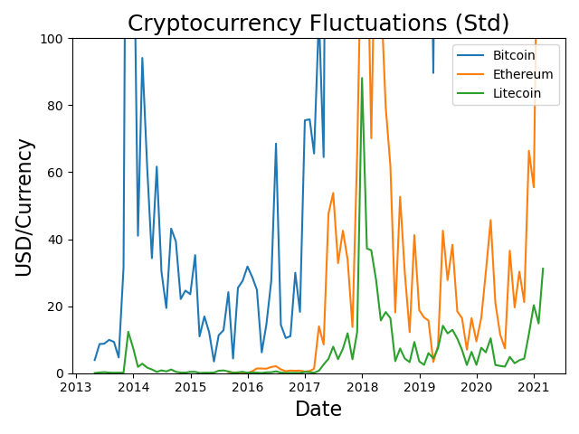
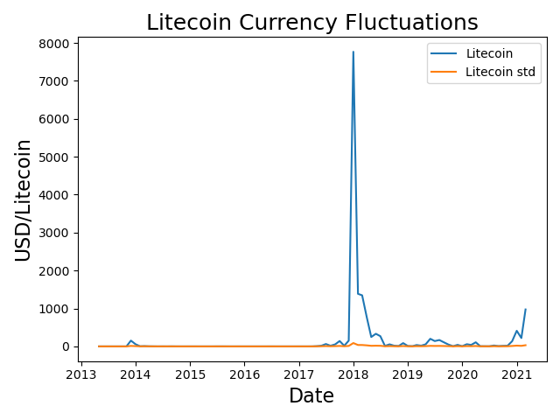
Crypto-Currencies
At first glance, the graphs show that the standard deviation of cryptocurrencies seem to be relatively stable.
However, on closer inspection, (take note of the y-axis) as compared to the traditional currencies.
We observed that Crypto Currencies are indeed significantly more volatile as compared to traditional currencies.

Slide 11
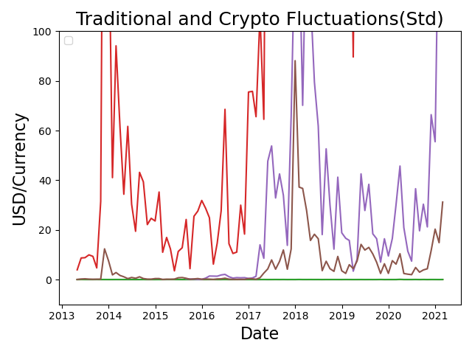
Traditional Vs Crypto Currencies

Slide 12
Question 2:
Are there any visible trends in the volatility of cryptocurrencies over time, either positive or negative?
Are Cryptocurrencies becoming less volatile (more stable investments) as they become more mainstream?
Kraken: David

Slide 13
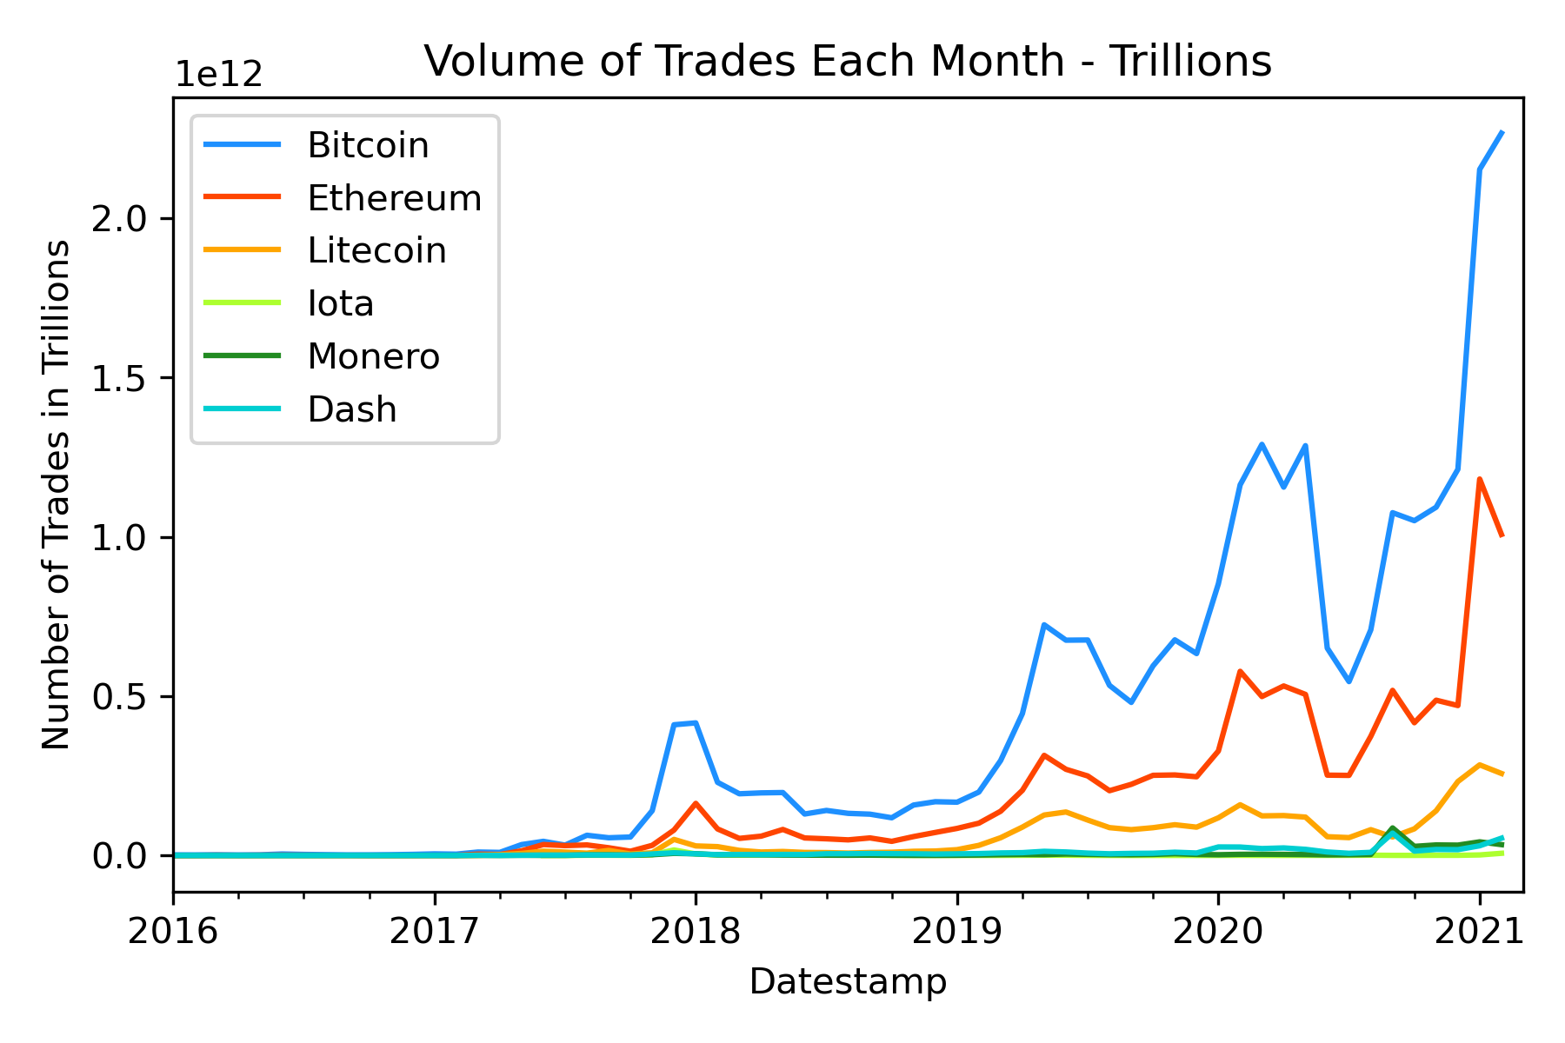
Firstly: When did Cryptocurrency go Mainstream?
What is mainstream? How do we define this?
We could argue that “Mainstream” could begin from when the currencies start to become frequently traded.
The graph to the right outlines the volume of transactions per month of each cryptocurrency
We can see that the coins started to become popular and regularly traded around late-2017

Slide 14
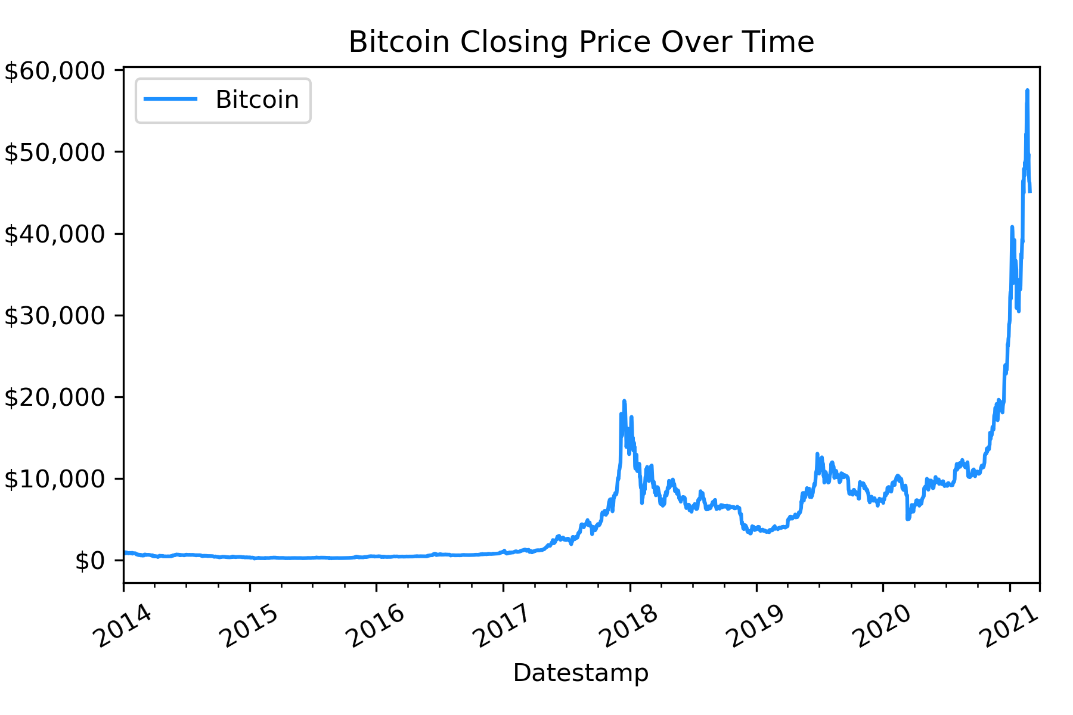
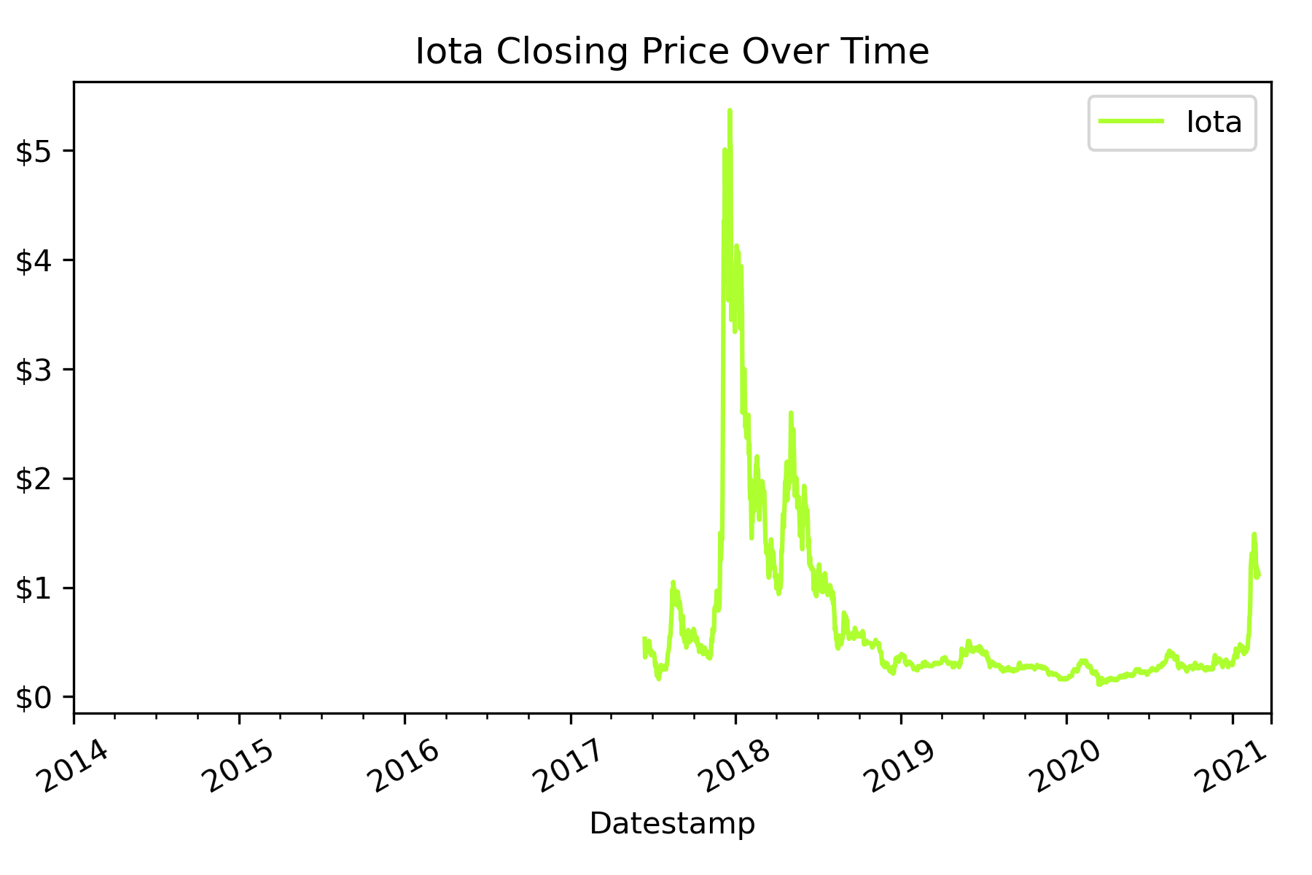
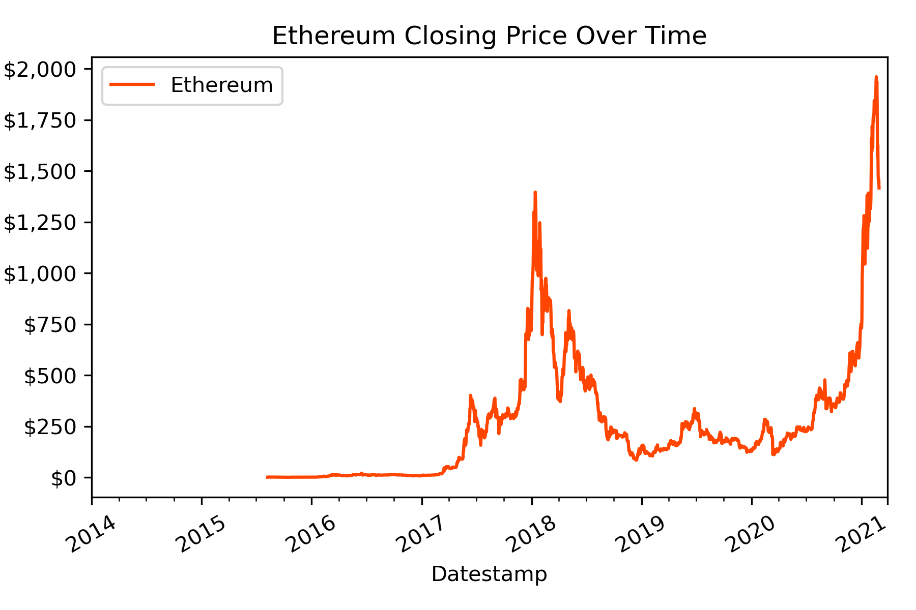
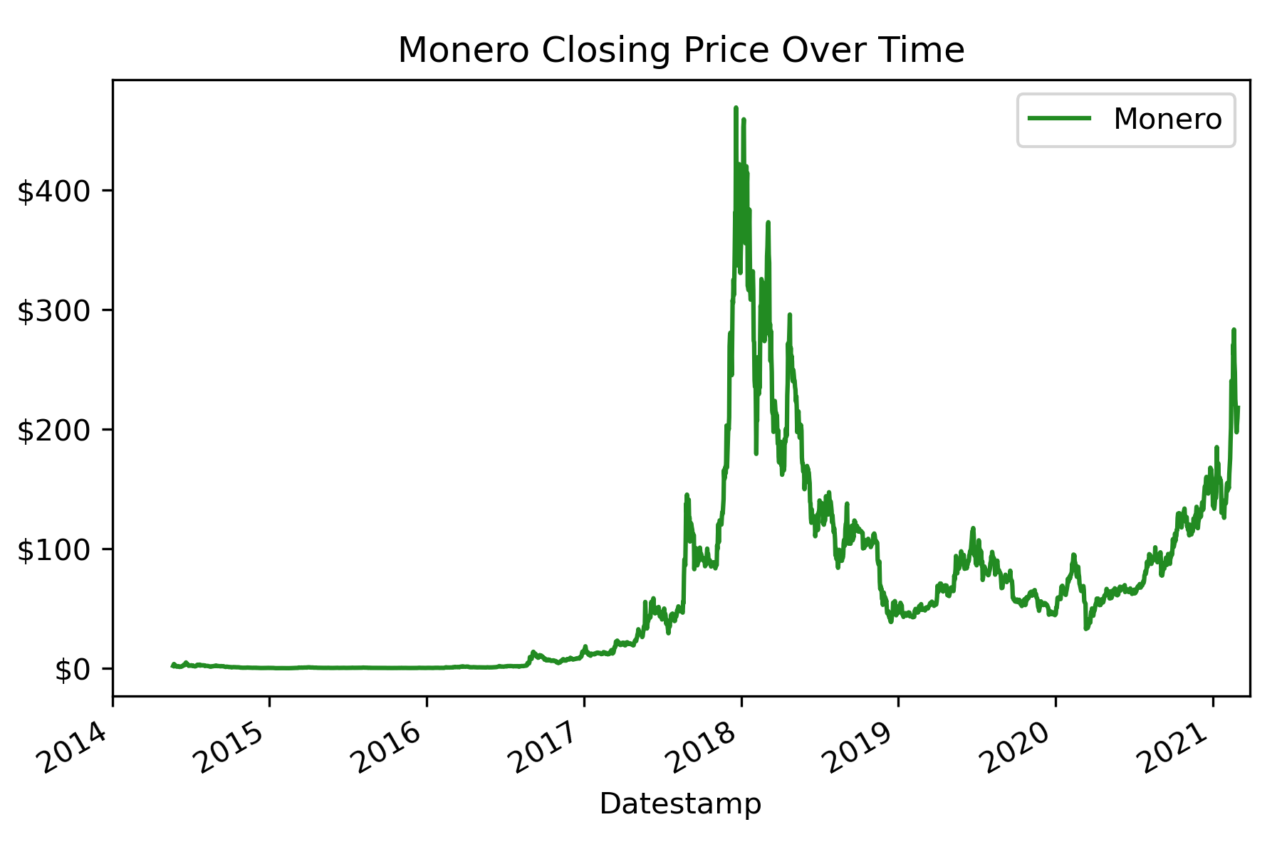
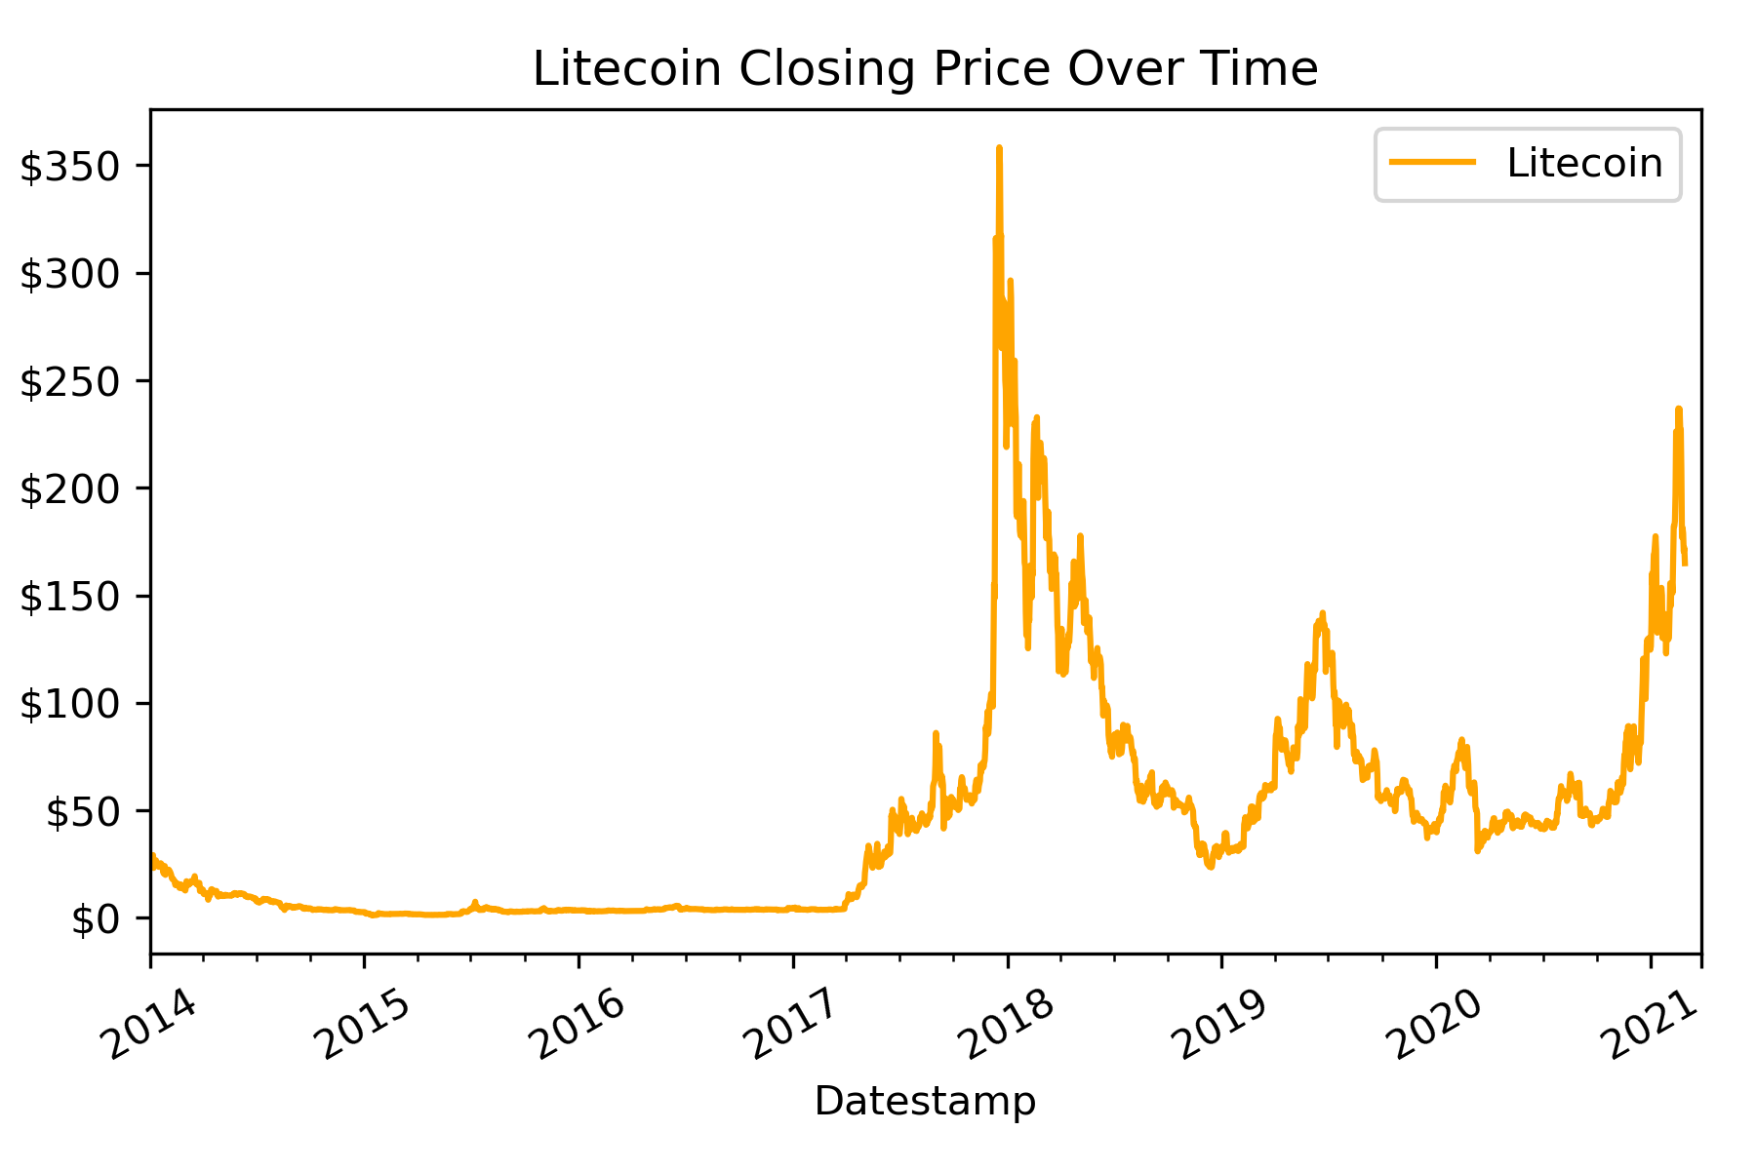
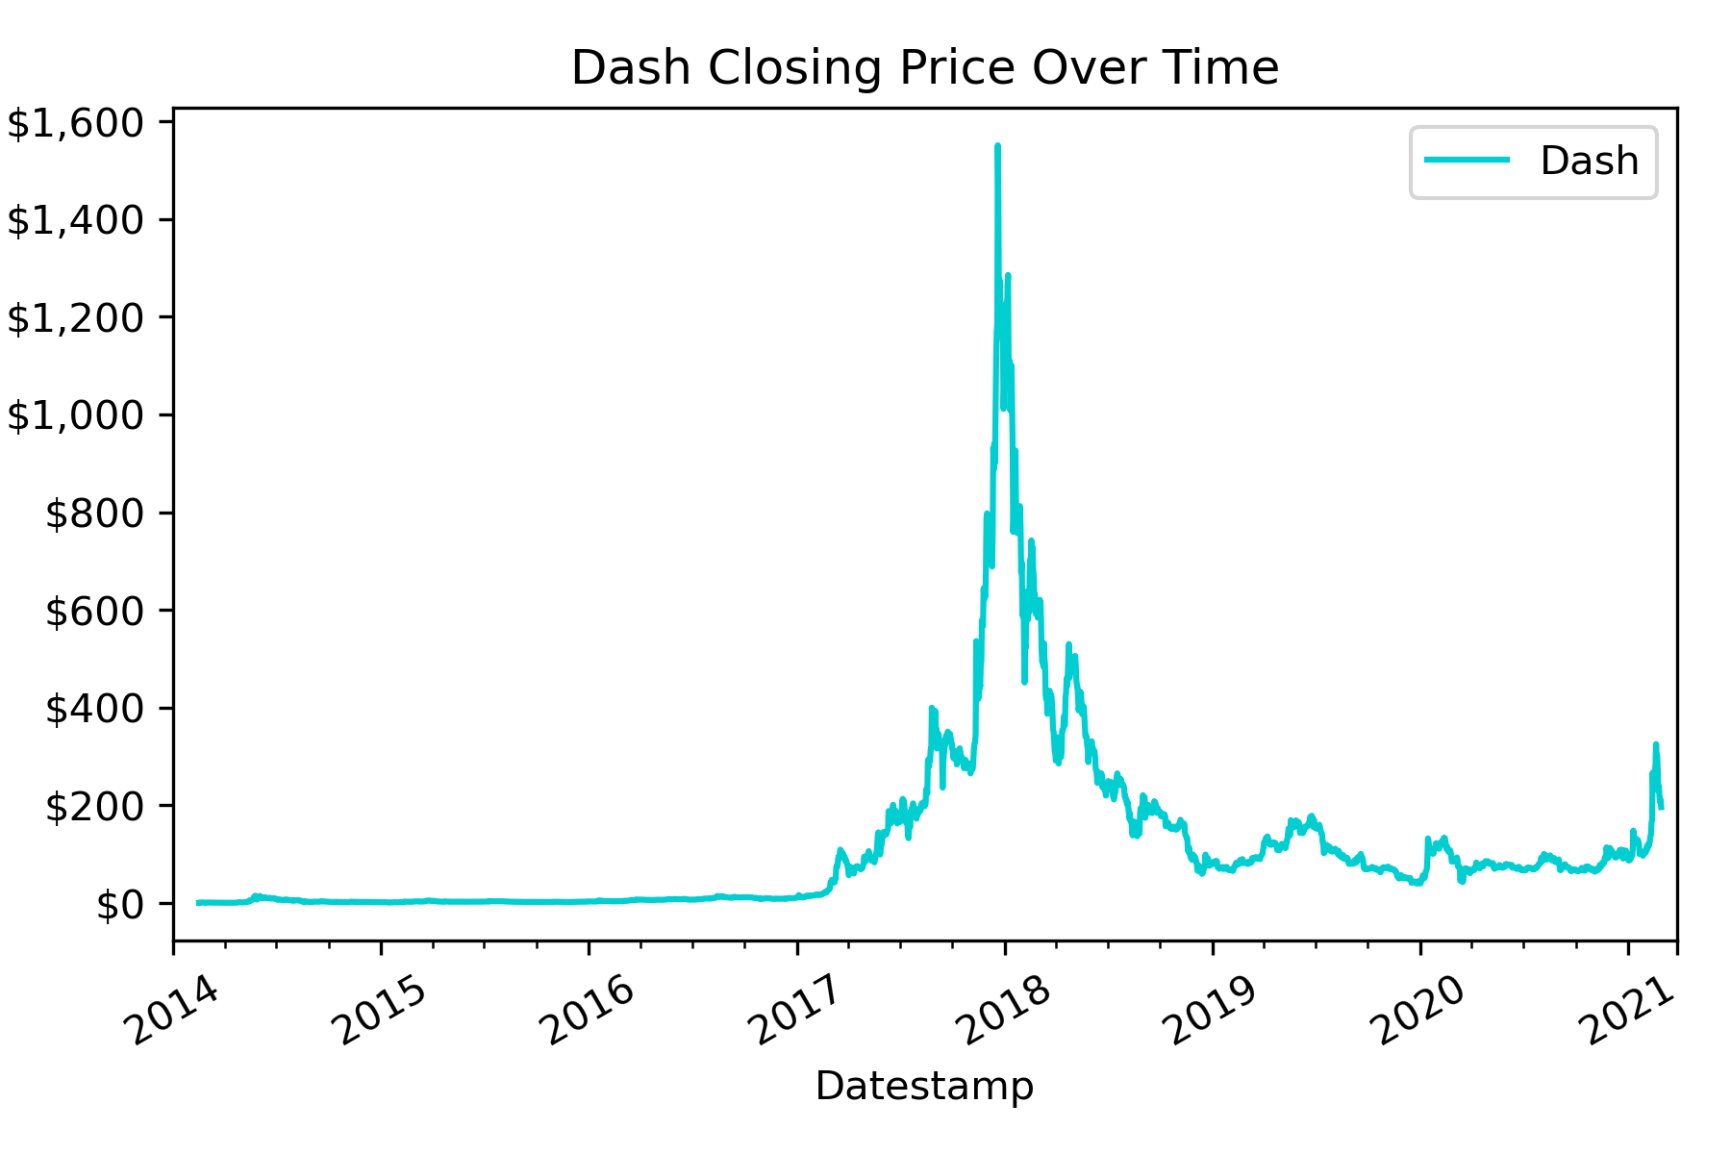
Coin Prices over Time
Correlating to our previous Trade Volume graph, prices of Cryptocurrencies starts to noticeably increase around late-2017, and this trend is repeatable
In early 2018, there is a massive boom across all cryptocurrencies, with most coins doubling or quadrupling their value in the space of a few months, followed by,
A bust in mid 2018, where the values of most cryptocurrencies deflate, and several do not recover
2021 has seen a boom in cryptocurrency as well, but Bitcoin is the clearest beneficiary of 2021 price growth

Slide 15
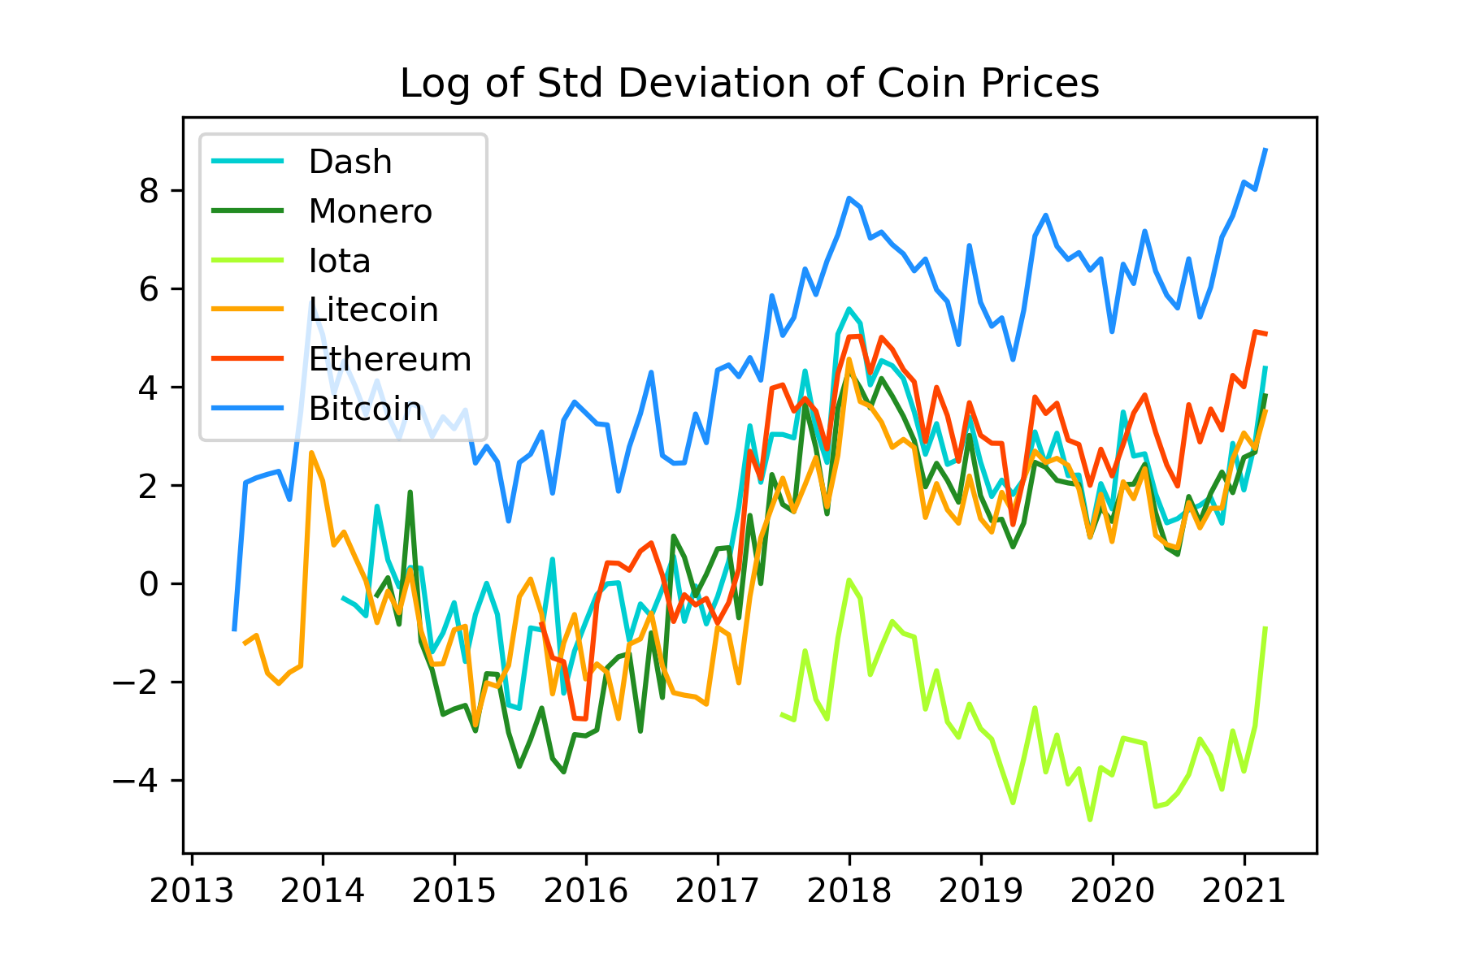
Standard Deviation of Coin Prices Over Time
The Standard Deviation function of Coin prices returned highly variable results, resulting in graphs that were off-the-scale and could not be easily compared
By getting the Logarithmic Return of Standard Deviation, it allowed us to plot Standard Deviation for multiple coins on one graph
We can see that overall, Standard Deviation of the coins tends to rise in mid-2017 to late-2018 and remains elevated
This could suggest that the variance of price data in a given month has increased overall since the 2018 boom

Slide 16
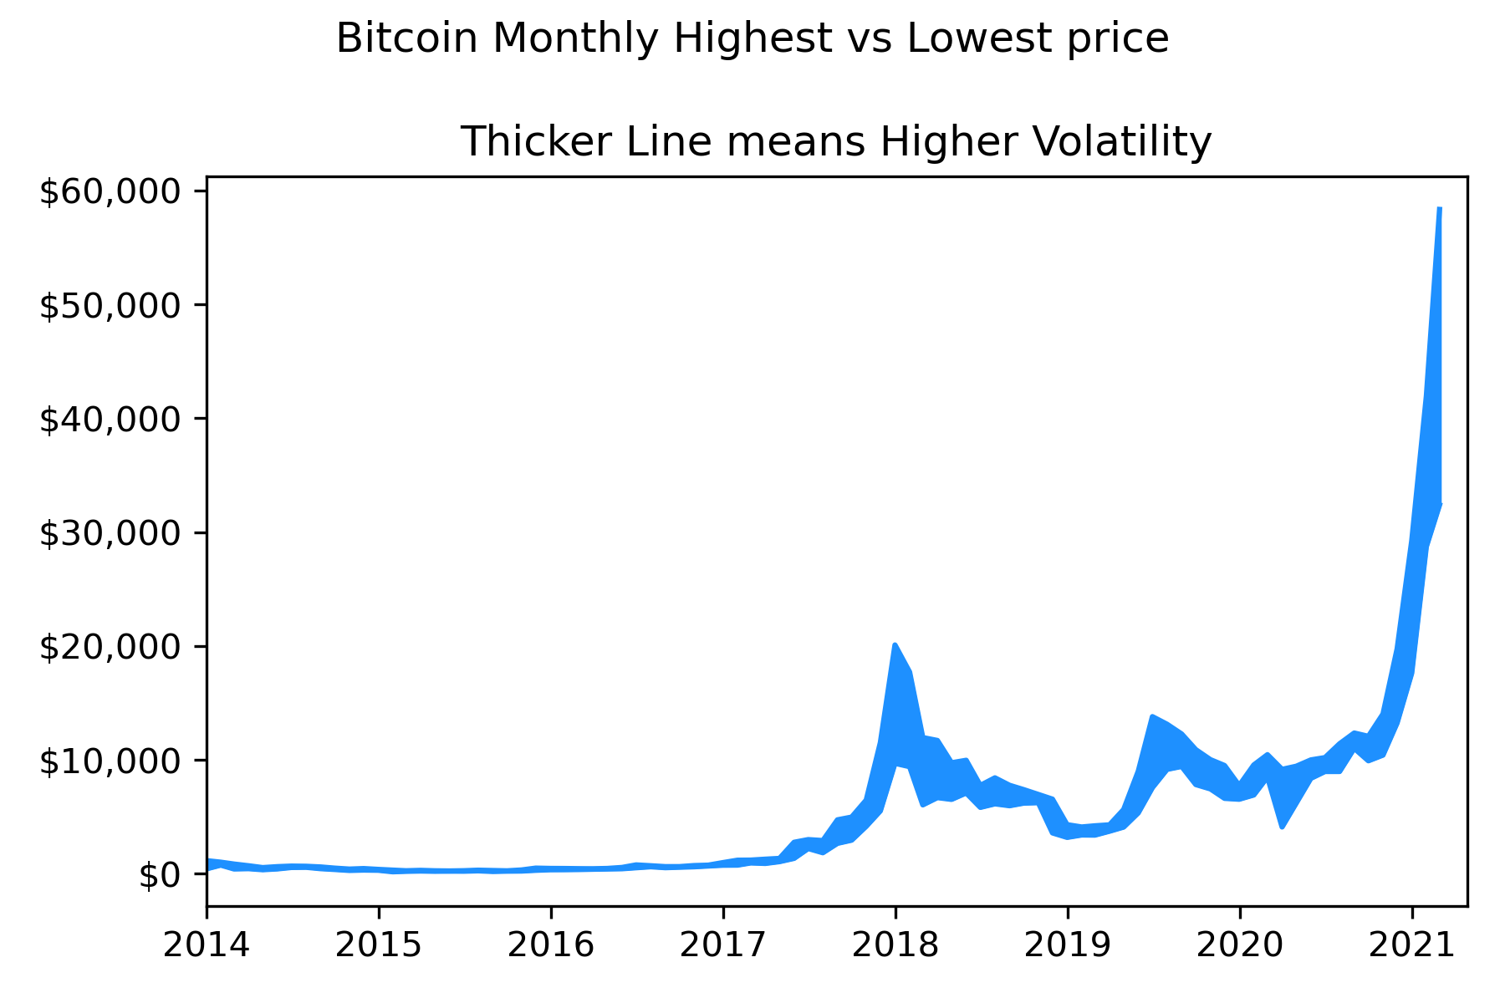
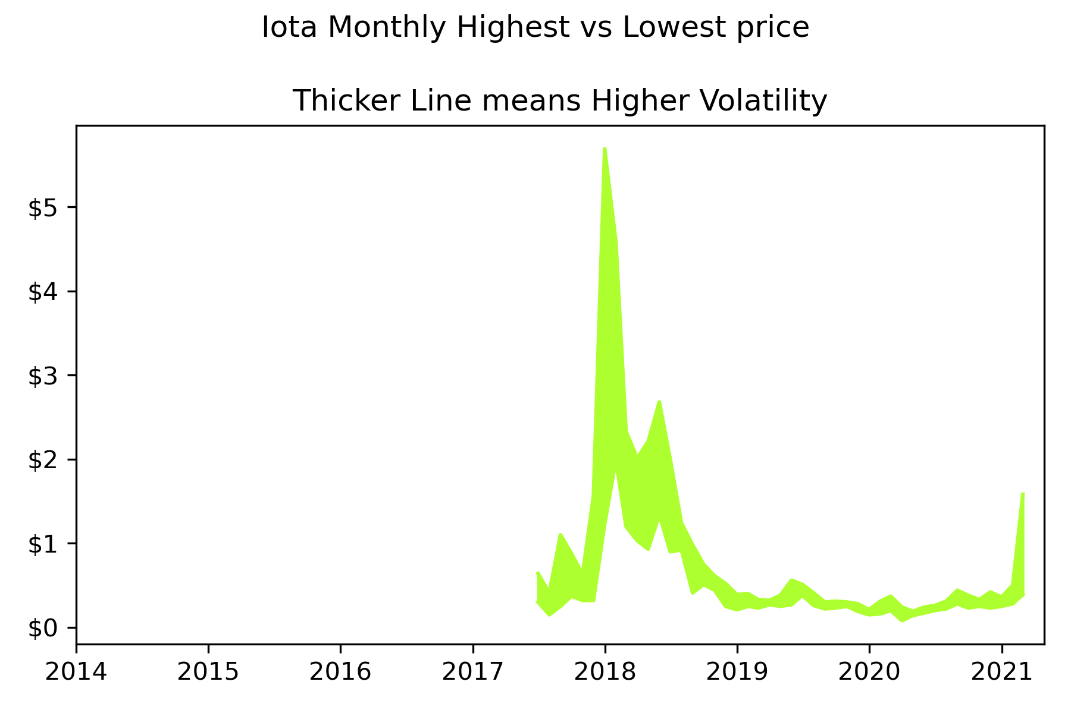
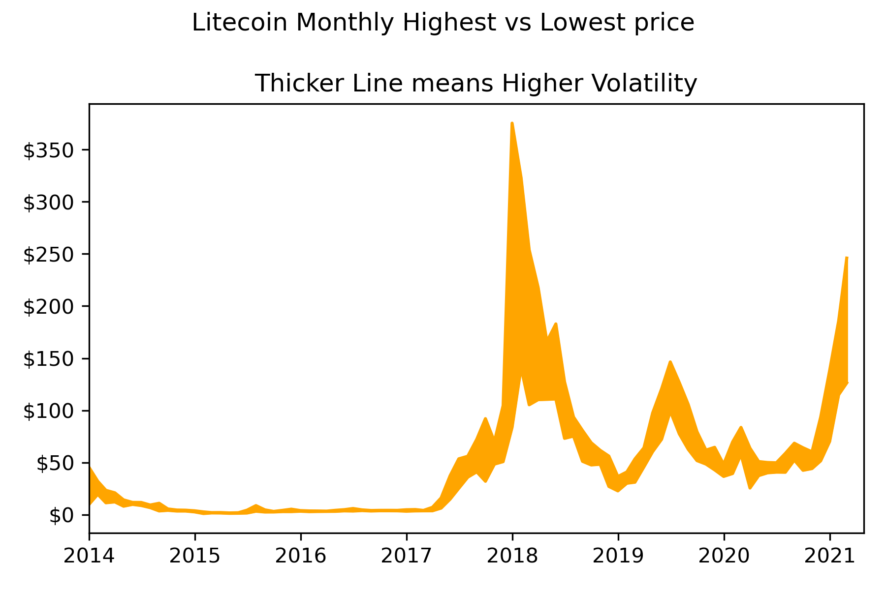
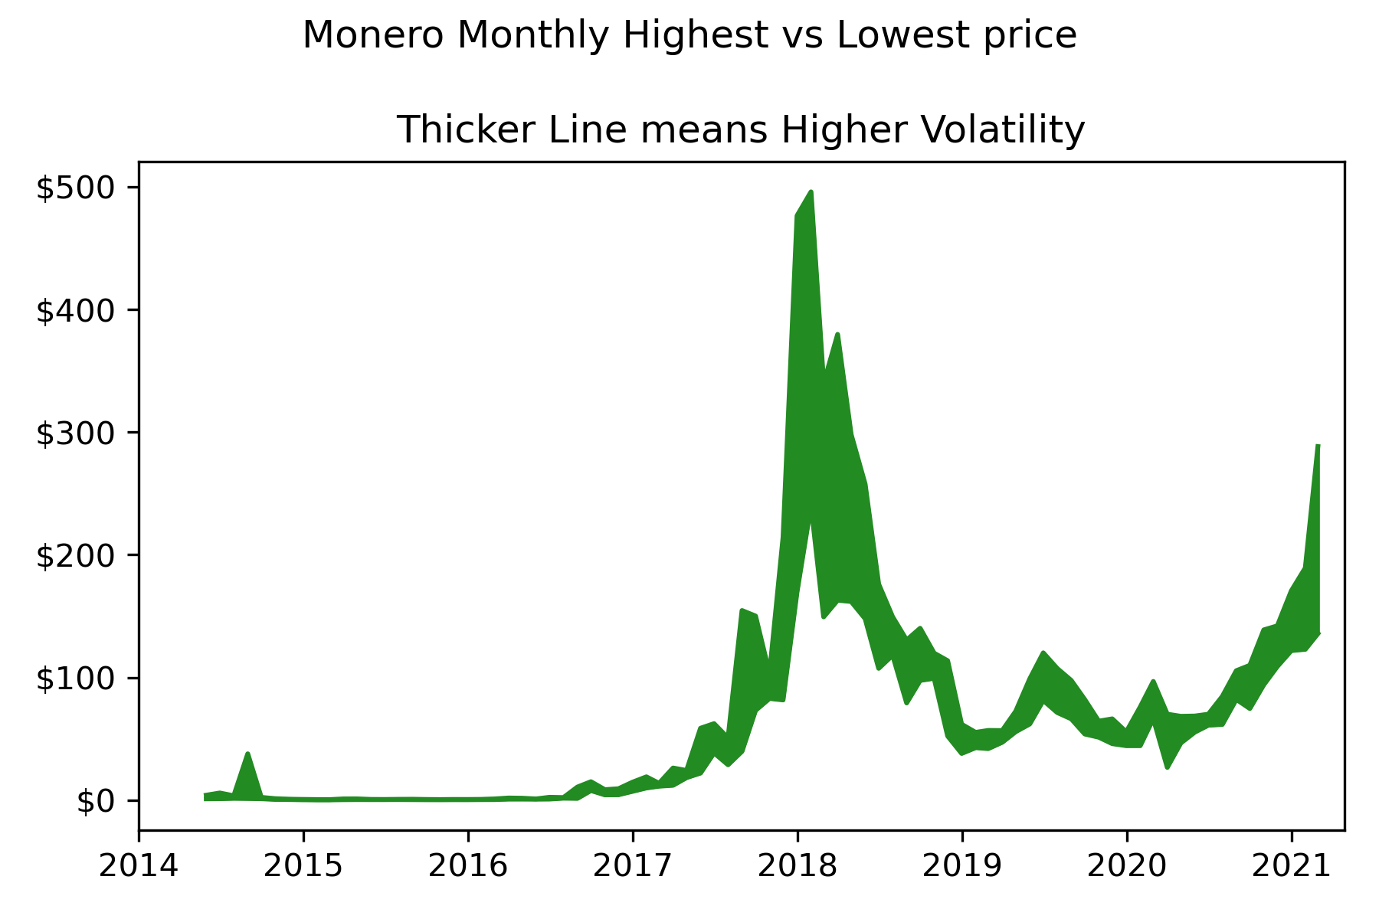
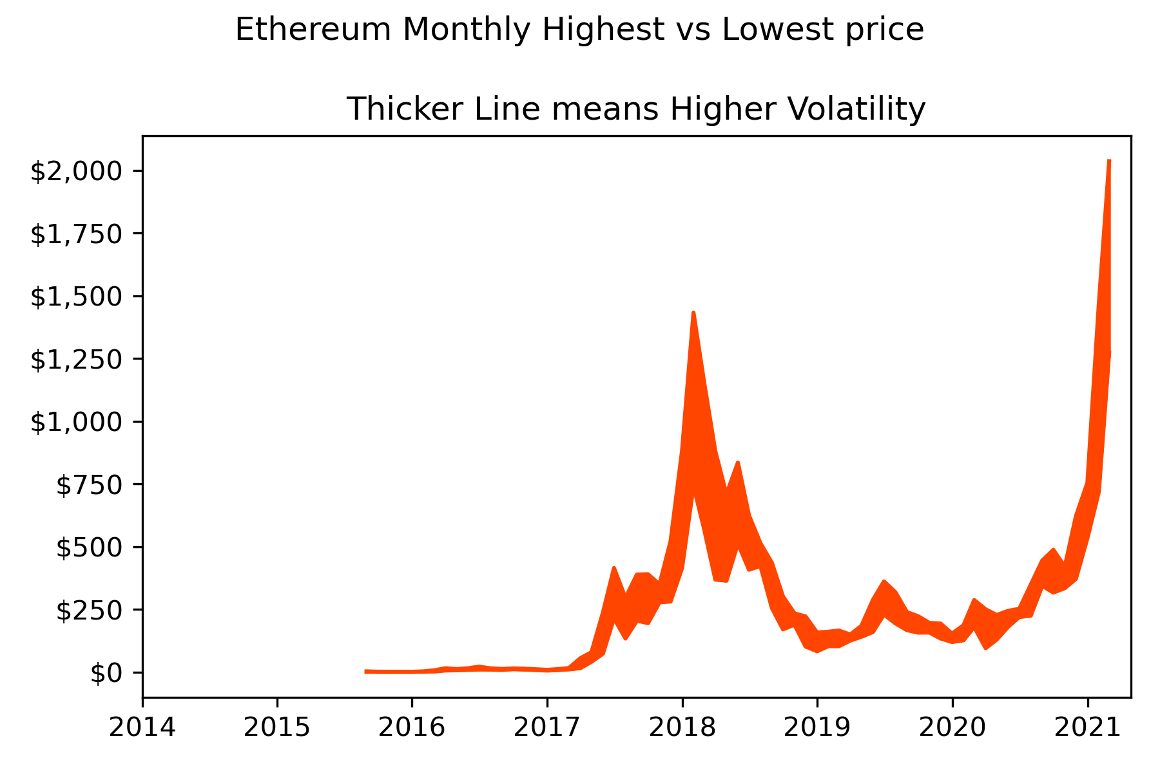
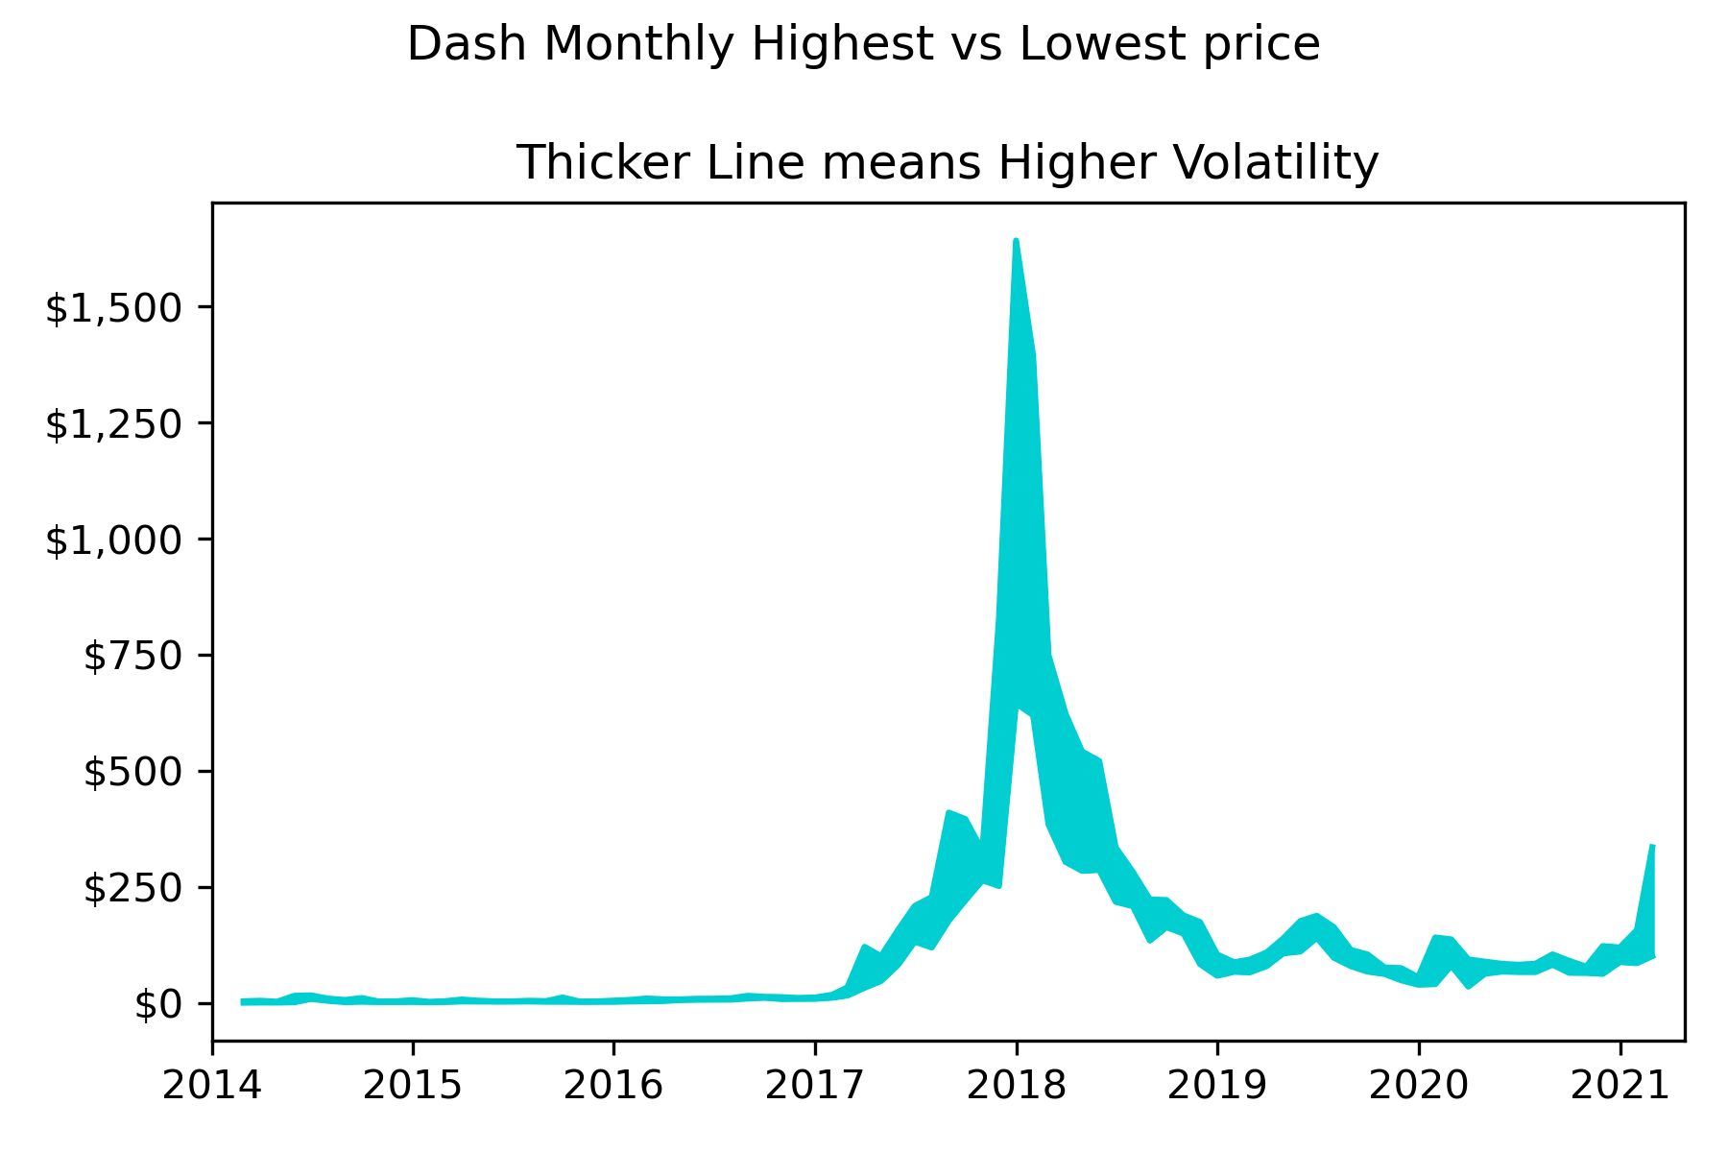
Maximum vs Minimum Prices Per Month
These graphs grouped coin prices by month, and extracted the highest and lowest price of each coin per month
Two lines were plotted, Max and Min, and the area between them filled
So, for these graphs, the thicker the line, the higher the price volatility
We can see some recurring patterns:
2018 Price boom sees high volatility
2021 price boom sees high volatility
Low volatility prior to mid-2017
Medium volatility elsewhere
We can see here that most cryptocurrencies have reduced their volatility levels following the 2018 boom

Slide 17
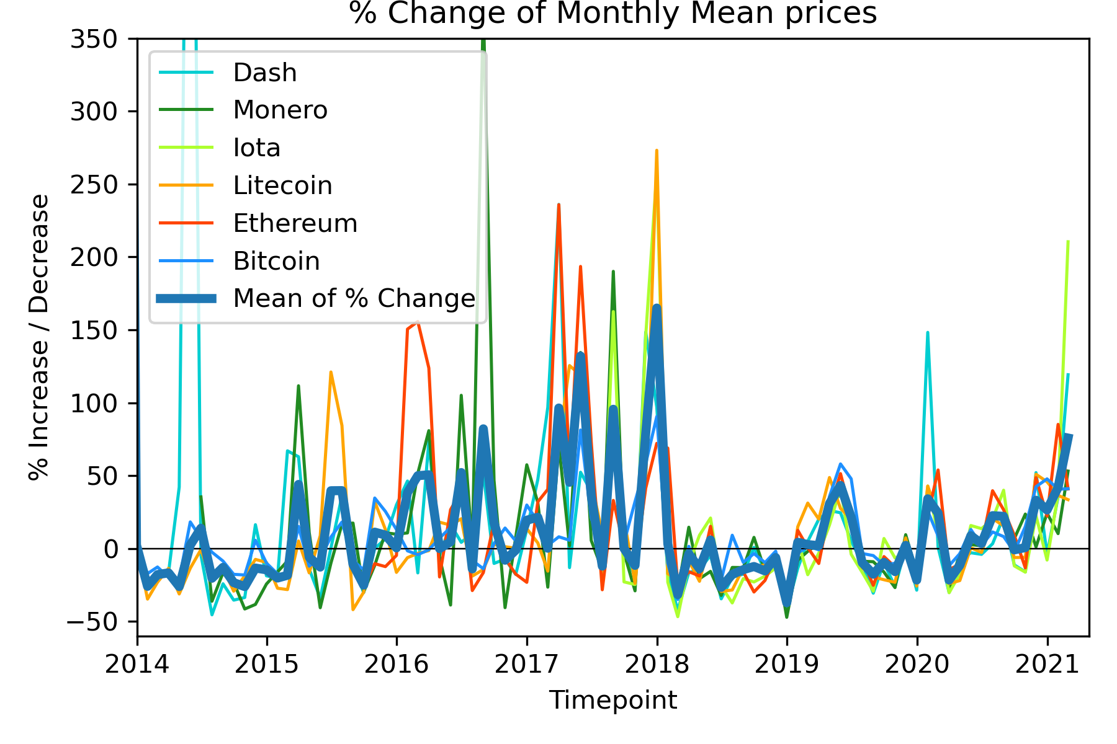
Coin Percent Change Over Time
This graph calculated the difference of average monthly prices, and plotted them as a percentage
We can see large price swings overall
However, the price swings seem to smooth out following the 2018 boom, and price growth / falls become more moderate by comparison

Slide 18
Question 3:
Is there a correlation between Traditional and Social Media mentions; versus cryptocurrency prices, trade volumes and volatility?
Kraken: Milena

Slide 19
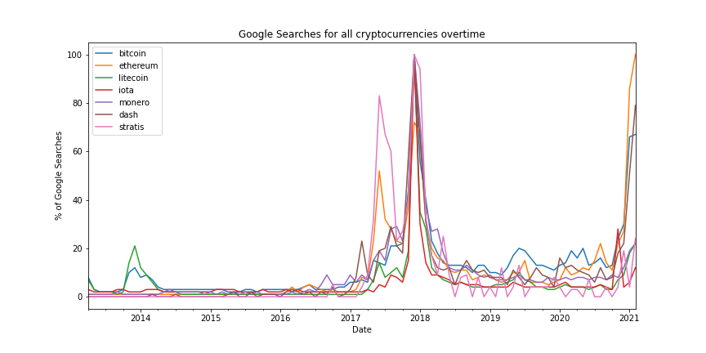
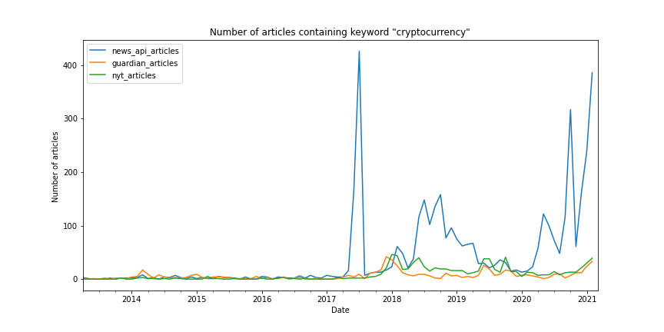
2. People's interest vs crypto volatility
The following graph highlights the correlation between google searches and the popularity between a set of different cryptocurrencies

Slide 20
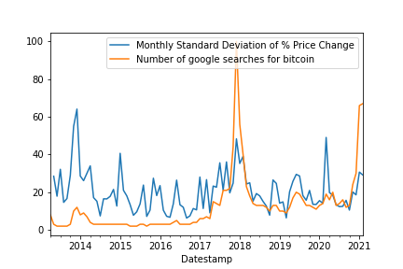
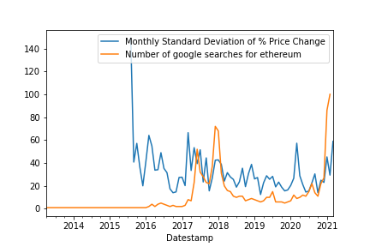
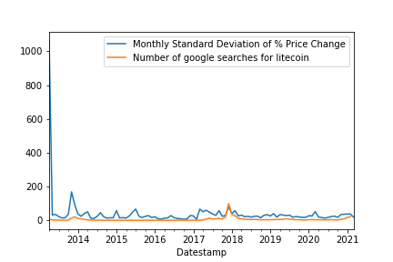
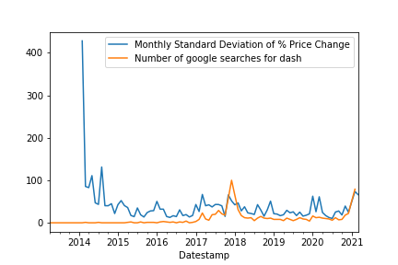
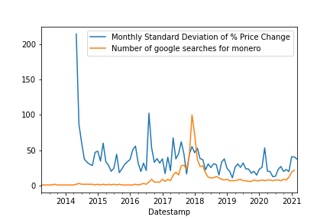
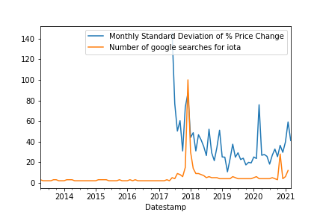
Google searches vs volatility
The following graphs take into account the amount of google searches and standard deviation of the crypto-currencies
There is a correlation between google searches and volatility
The graphs highlights that the amount of google searches has some sort of effect on volatility. But the extent of that effect is not abundantly clear.
However, our results show that google searches could result in either an increase or decrease of volatility in a particular crypto-currency.

Slide 21
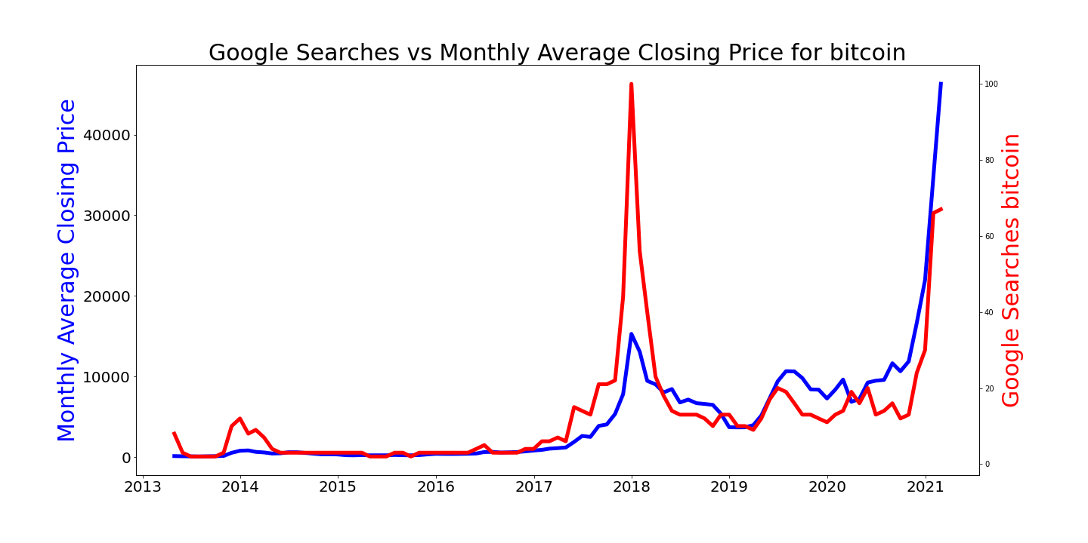
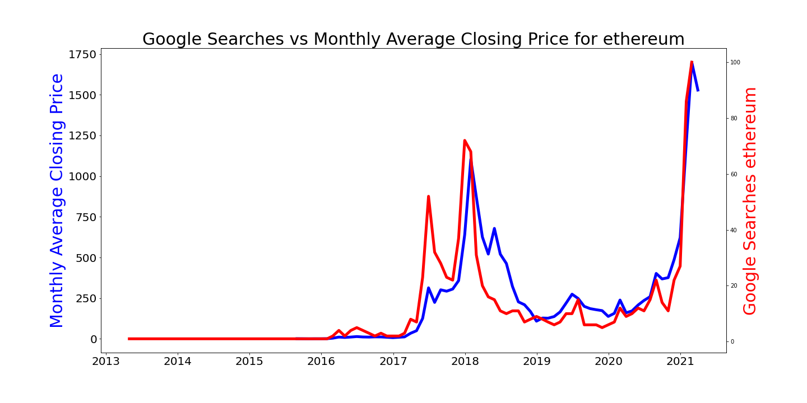
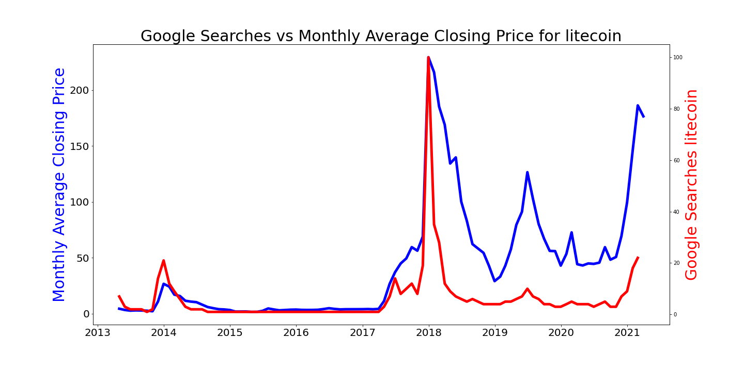
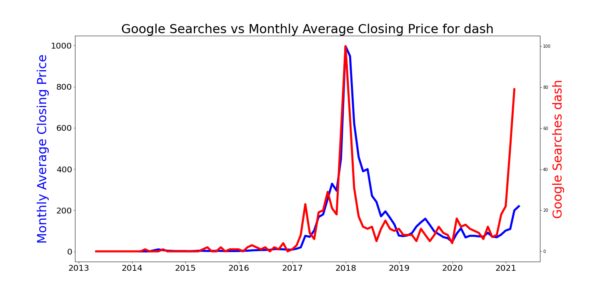
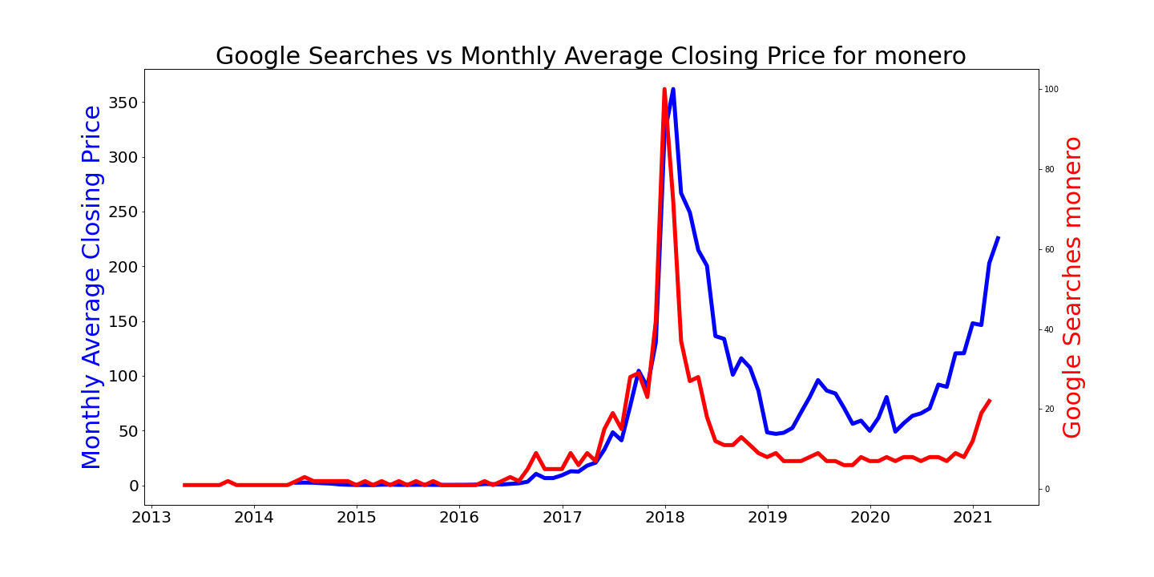
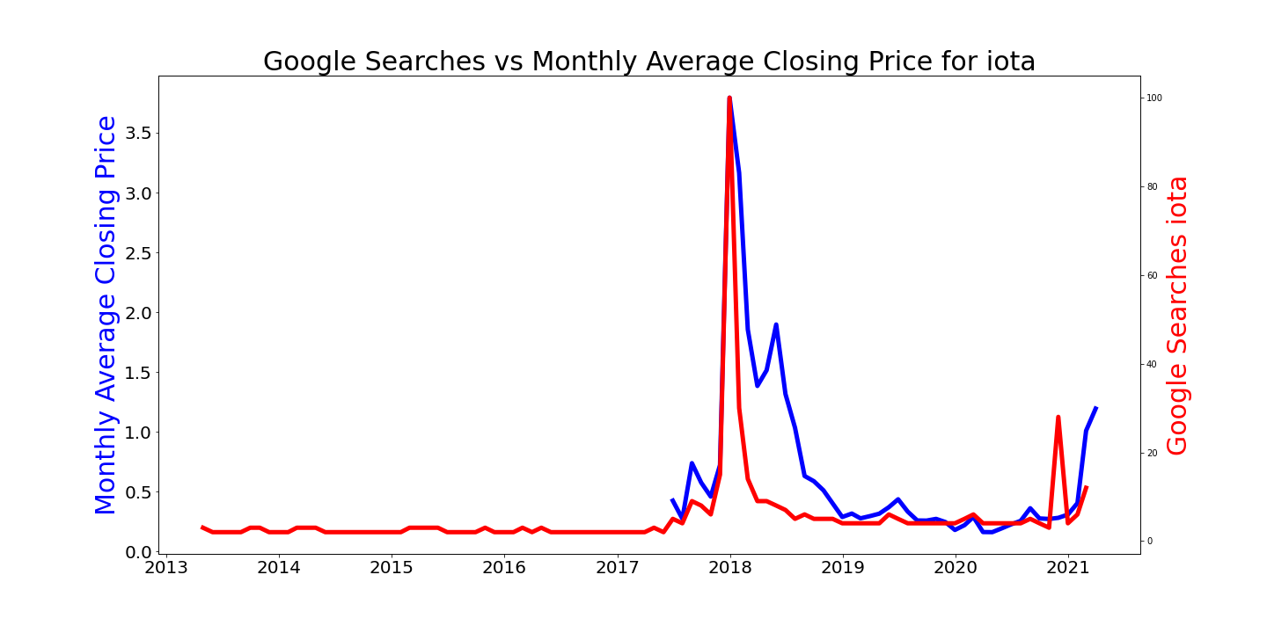
Google searches vs closing price
The following graphs show a correlation between google searches and a crypto-currency's closing price.
Generally, if there is an increase in interests for a particular crypto-currency, its price tends to rise.
From the following graphs, we can conclude that interest drives price.

Slide 22
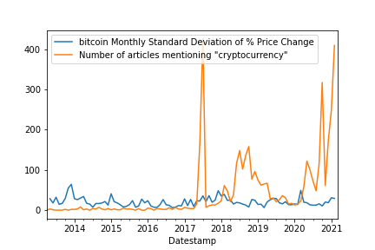
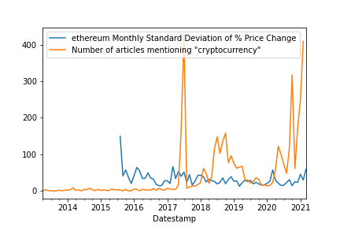
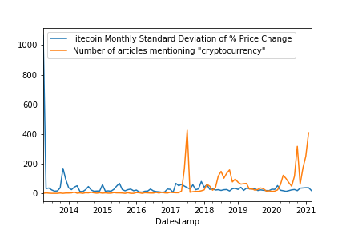
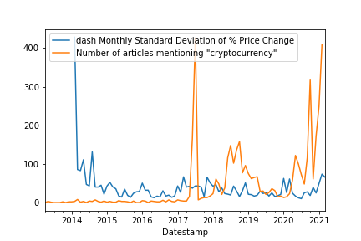
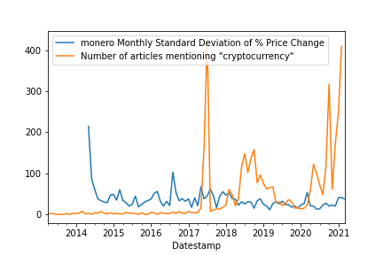
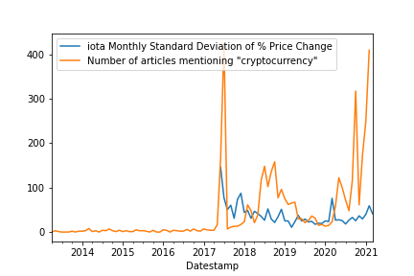
Number of articles vs volatility
The following graphs investigates the relationship between the number of articles on crypto-currencies and volatility.
The graphs highlight that.
Media coverage drives interests
However, it does not influence volatility within crypto-currencies.

Slide 23
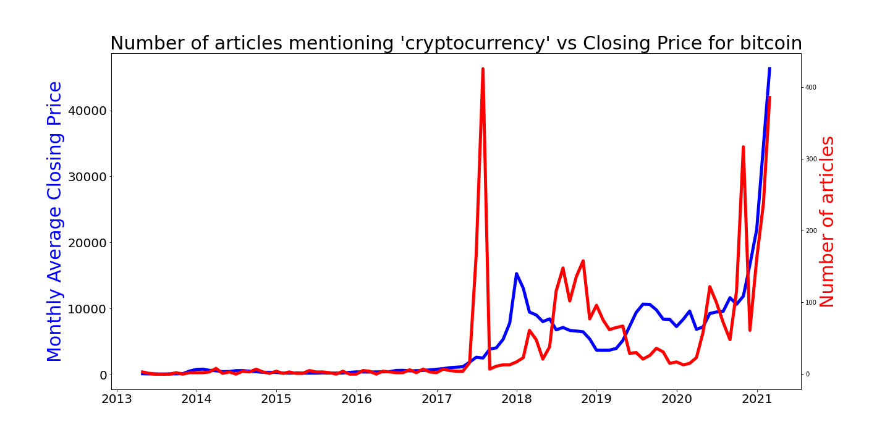
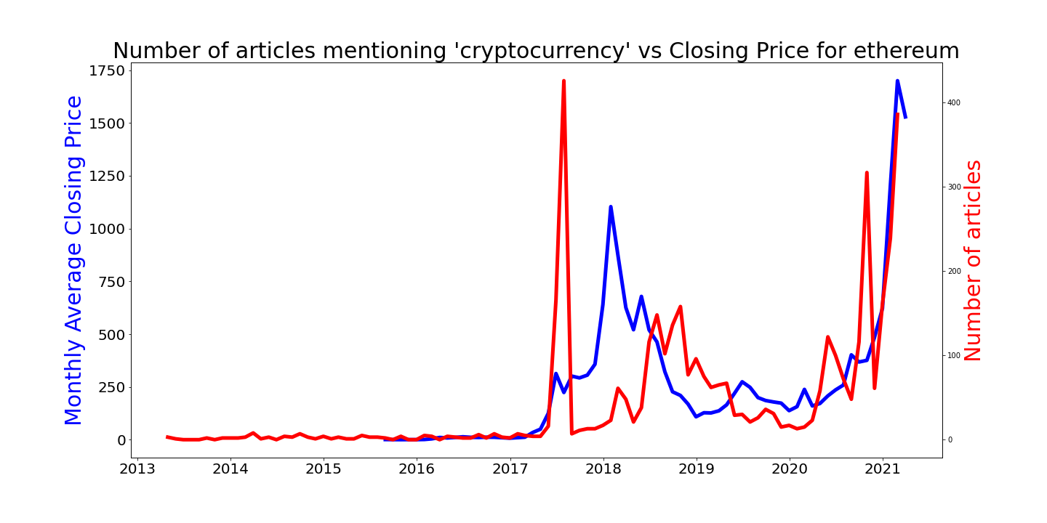
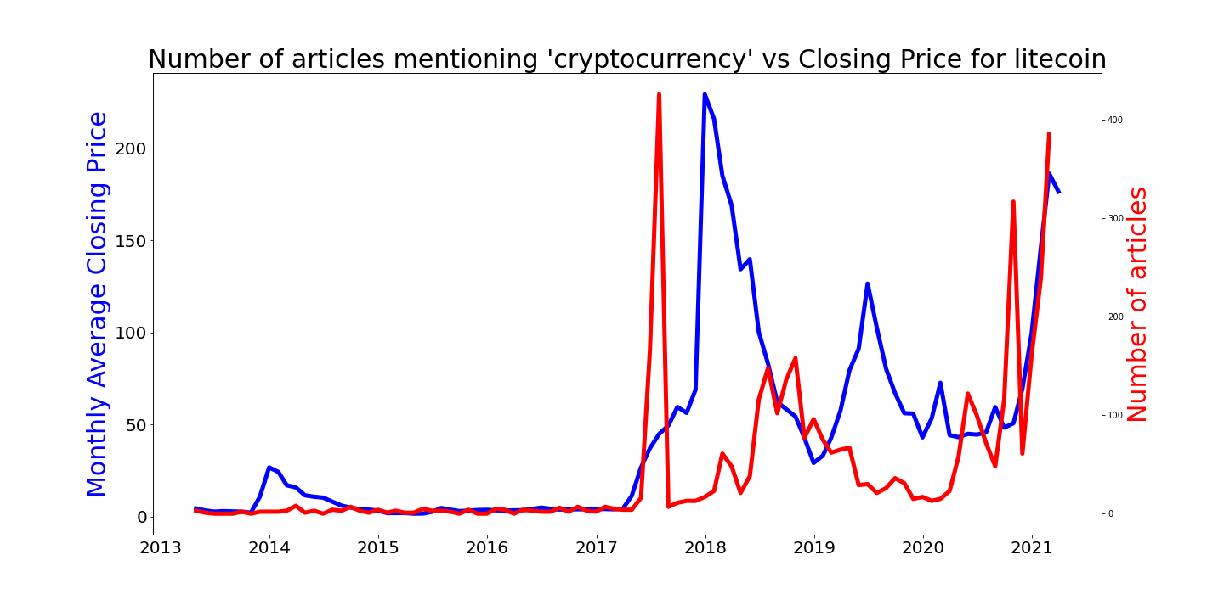
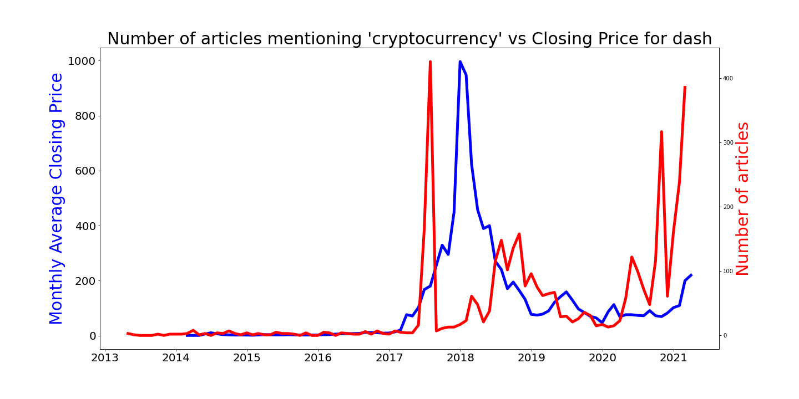
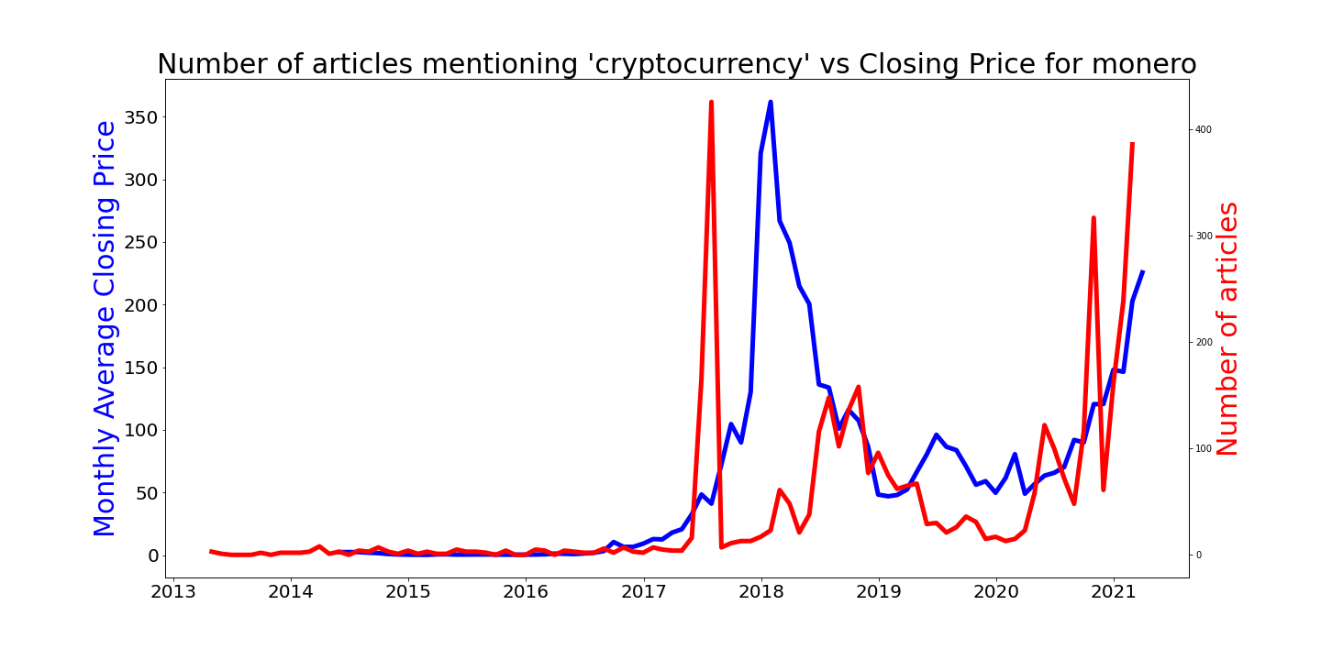

Number of articles vs closing price
The following graphs highlights the relationship between the number of crypto-currency articles published and the closing prices of cryptocurrencies.
The early 2017 coverage pof cryptocurrencies resulted in huge booms and price increases for crypto-currencies.
ProTip: Our data suggests that this is happening again in 2021.

Slide 24

COrrelation between google searchs/Number of articles vs closing price/volatility

Slide 25

3. Social media vs crypto volatility

Slide 26
Key Findings
PAY ATTENTION: if you want to potentially get rich...
It appears that Cryptocurrencies are indeed more volatile than traditional currencies
The graphs showing Standard Deviation of Traditional currencies vs Crypto currencies is off the scale
Price growth and price swings of cryptocurrency is significantly greater than traditional currencies
It’s hard to fully determine if Cryptocurrency volatility is stabilizing over time. The data suggests otherwise, that volatility has actually increased overall since the concept went mainstream. However, certain factors, including a drop in the differential of Mean Percentage Change Per Month, and a decrease in Log Return of Standard Deviation for all the concerns following the 2018 boom, suggests that in some respects they are more stable following the 2018 boom.
The min & max graphs seems to suggest that after cryptocurrency went mainstream in mid 2017, price volatility has increased significantly
The standard deviation graphs seem to suggest that the variance of prices in a given month has increased since mid 2017
The % change per month graph perhaps contradicts this, showing that the overall price changes have smoothed out
It appears that Social Media and Traditional Media do have correlations to various cryptocurrency trends, but that Social Media and Traditional Media are not influencing the volatility levels of cryptocurrency.
There does appear to be a correlation between Social Media mentions and Traditional Media articles, versus the price and volatility of Cryptocurrency
There appears to be a clear correlation of the volume of cryptocurrency trades vs the number of google searches for the cryptocurrency
The more media and search activity received by cryptocurrencies, potentially results in price swings
Bitcoin is particularly correlated to price gains and falls based on media and social media interest
Media covering is driving interest, which does seem to be correlated to price, but does not seem to be driving volatility

Slide 27
Q&A

